Slide 1
Poker with Self-Play
Deep Recurrent Q-Learning
Lê Gia Khang - 21522189
Lê Duy Khang - 21522188

Slide 2
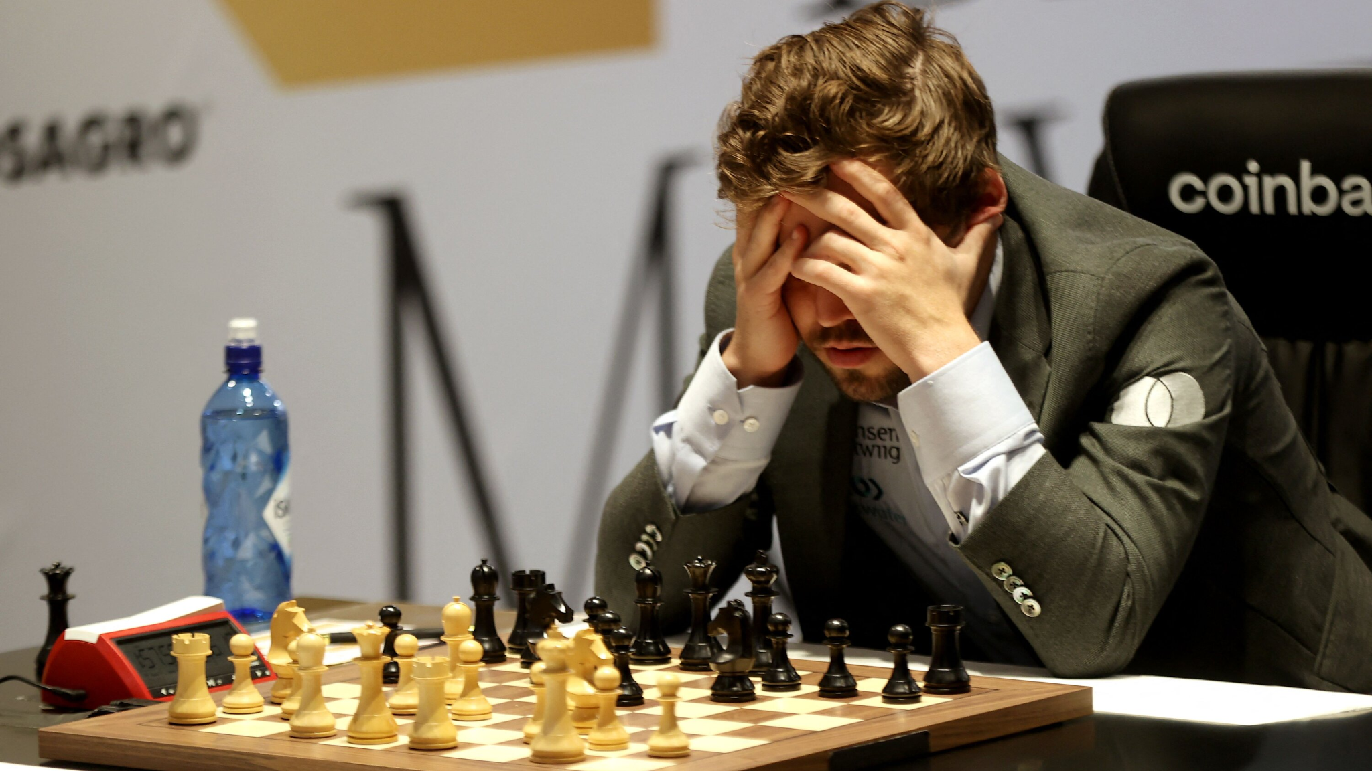
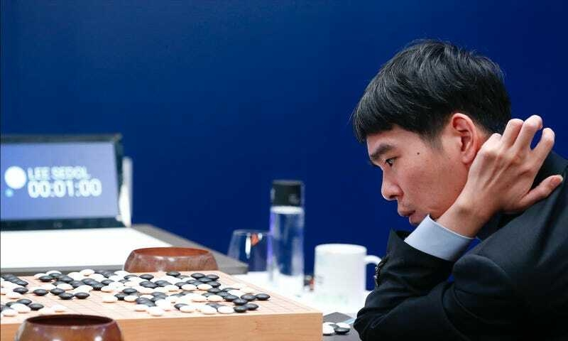
Introduction
Deep Reinforcement Learning achieved super-human performance in games like Chess, Checkers, Go, Atari. All of them are perfect- information games.
Perfect-information game is a type of game where all players have complete knowledge of game’s state at all time.

Slide 3
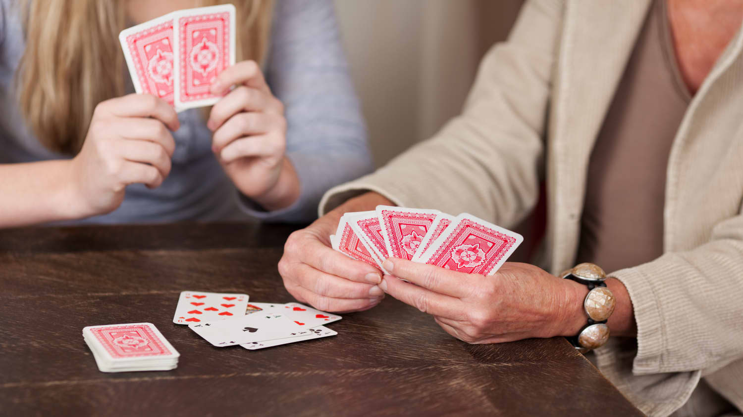
Introduction
How about imperfect-information games?
Imperfect-information games are a type of game where players have limited or incomplete knowledge of the game's state, like playing cards.
RL models tend to perform better in perfect-information games compared to imperfect-information games. RL models need to learn to infer and reason about the hidden information based on observed actions and outcomes.

Slide 4

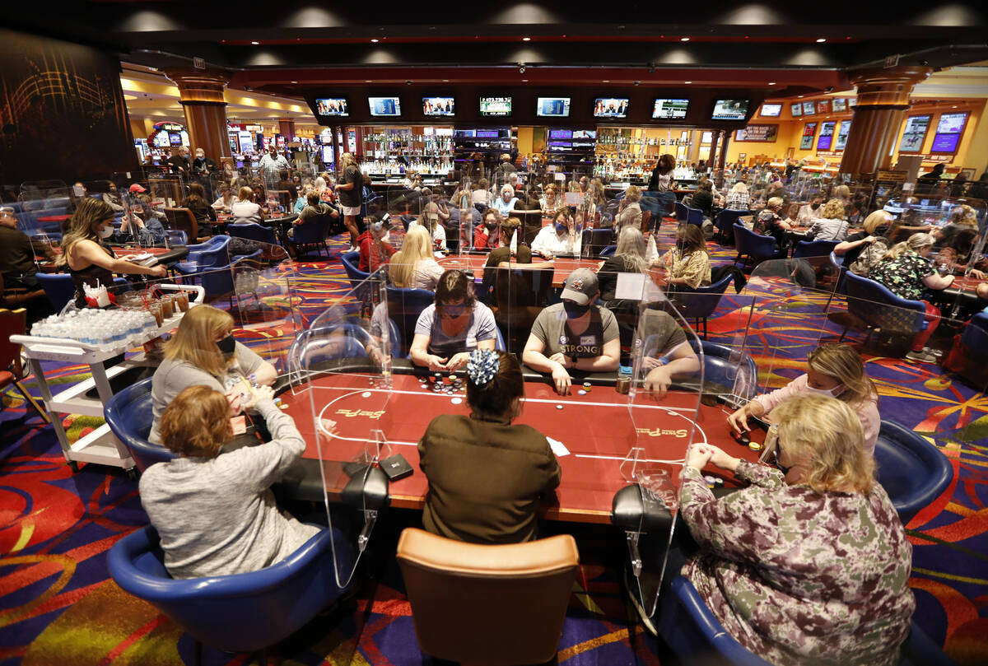
Poker
Poker is a famous mind game. We have poker coaching, multiple annual poker tournaments.
The game of poker has long been regarded as a benchmark for human intelligence due to its complex decision-making, strategic thinking, and inherent uncertainty
Poker requires player to make strategic choices, while accounting for hidden information. This aspect of poker introduces an element of bluffing, risk assessment, and adaptation that makes it an intriguing testbed for AI research

Slide 5

Our Project
In our project, we consider Limit Texas Hold-em and apply Deep Recurrent Q-Learning to induce bias of poker having sequentially dependent.
We train our agent against itself (Self-Play) and evaluate on playing against Random Agent of RLCard Toolkit.

Slide 6
Limit Texas Hold-em
Texas Hold’em is a popular betting game. Each player is dealt two face-down cards, called hole cards. Then 5 community cards are dealt in three stages (the flop, the turn and the river).
Each player seeks the five best cards among the hole cards and community cards. There are 4 betting rounds.
During each round each player can choose “call”, “check”, “raise”, or “fold”.
In fixed limit Texas Hold’em, each player can only choose a fixed amount of raise. And in each round the number of raises is limited to 4.

Slide 7
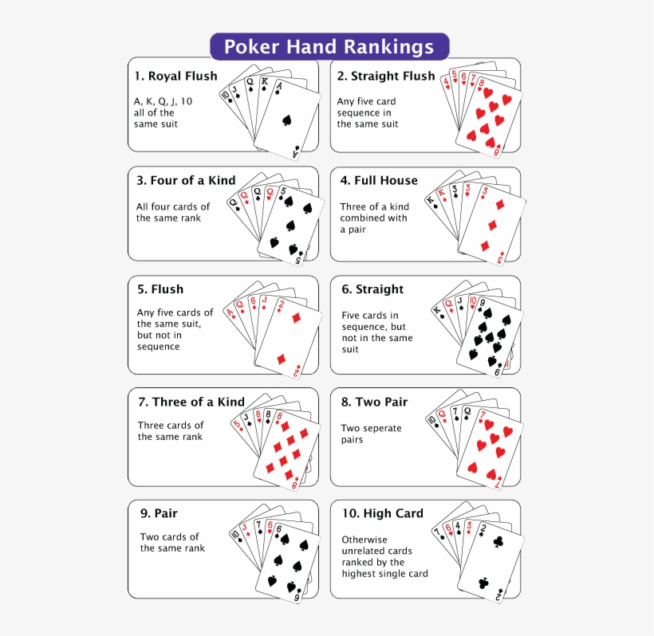
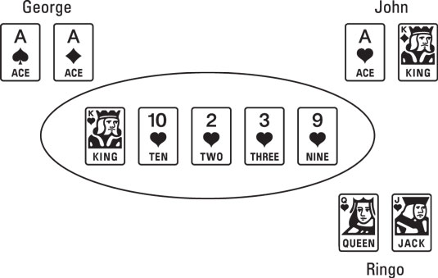
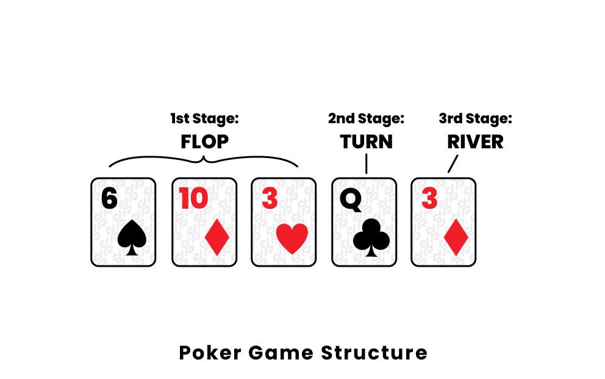
Limit Texas Hold-em

Slide 8
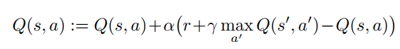
Q-learning
Q-learning is a model-free off-policy algorithm for estimating the long-term expected return of executing an action from a given state.
Q-values are learned iteratively by the following formula:

Slide 9
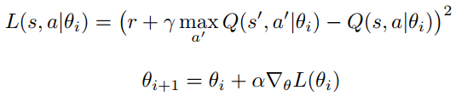
Deep Q-learning
In practice, this basic approach Q-learning is totally impractical
Instead, it is common to use a function approximator to estimate the action-value function, Q(s; a; θ) ≈ Q∗(s; a). The model is a neural network parameterized by weights and biases collectively denoted as θ.
Updates are now made to the parameters of the network to minimize a differentiable loss function

Slide 10
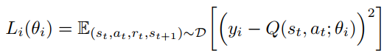

Deep Q-learning
However, such updates can oscillate or diverge.
At each training iteration i, an experience e_{t} = (s_{t}; a_{t}; r_{t}; s_{t+1}) is sampled uniformly from the replay memory D. The loss of the network is determined as follows:

Slide 11
Partial Observability
A Partially Observable Markov Decision Process (POMDP) can capture dynamics of real word environments.
In imperfect-information game, the agent only receives an observation. In the general case, estimating a Q-value from an observation can be arbitrarily bad because Q(o, a|θ) != Q(s, a|θ).
Adding recurrency to Deep Q-Learning allows the Q-network network to better estimate the underlying system state, narrowing the gap between Q(o, a|θ) and Q(s, a|θ).

Slide 12
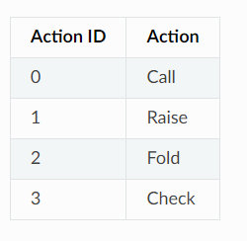
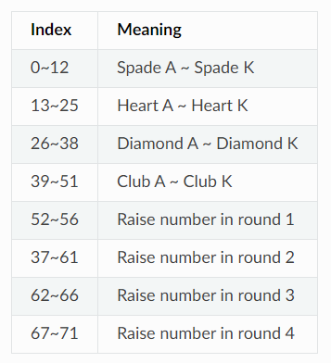
State Representation and Action Space
The state is encoded as a vector of length 72. The first 52 elements represent cards, where each element corresponds to one card. The hand is represented as the two hole cards plus the observed community cards so far. The last 20 elements are the betting history.
There 4 actions in Limit Texas Hold’em.
The reward is calculated based on big blinds per hand. For example, a reward of 0.5 (-0.5) means that the player wins (loses) 0.5 times of the amount of big blind.

Slide 13
Deep Recurrent Q Network
The order in which cards are presented to the agent is very important in the game of poker.
We present recurrent formulations of popular reinforcement learning models to play poker in order induce the bias that card order is important in the game of poker
we implemented a recurrent approximation of Q-learning so that the agent is able to integrate information across different timesteps in a given hand

Slide 14
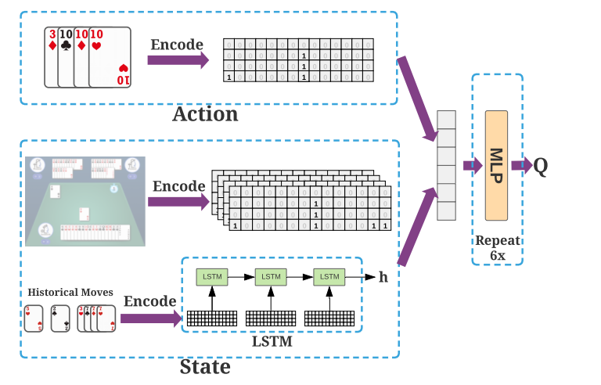
Deep Recurrent Q Network
Our DRQN consists of an LSTM and a MLP layer.
LSTM to encode historical moves and current state.
A linear layer outputs a Q-Value for each action
*Note: an image is from DouDizhu game, not Poker. For visualization purpose only.

Slide 15
Stable Recurrent Update
Updating a recurrent network requires each backward pass to contain many time-steps of game states and target values.
Additionally, the LSTM ’s initial hidden state may either be zeroed or carried forward from its previous values

Slide 16
Bootstrapped Sequential Updates
Episodes are selected randomly from the replay memory and updates begin at the beginning of the episode and proceed forward through time to the conclusion of the episode.
The targets at each timestep are generated from the target Q-network, Q^. The RNN ’s hidden state is carried forward throughout the episode.
Sequential updates have the advantage of carrying the LSTM ’s hidden state forward from the beginning of the episode.
However, by sampling experiences sequentially for a full episode, they violate DQN’s random sampling policy.

Slide 17
Thanks for listening

